Slide 1

Smart Irrigation with Analytics - Using SAP, IoT and Watson
Chandra Prakash Meher
SAP MDG Technical Consultant
Project: Suncor Energy
Sap Idea no:SAPIDEAS-I-485

Slide 2
Agenda:
Overview of the Idea
Process flow
Specific Use case(s)
Idea detail and Demo
Expected Benefits
Industry or Countries to be targeted
Q&A

Slide 3
Overview of the Idea
Agriculture being an important sector, irrigation plays a vital role in proper yield.
Problem Statement:
Agriculture being an important sector, irrigation plays a vital role in proper yield. Thus if it doesn’t maintained then it would affect the GDP too.
With the growing technologies, WSN and cloud computing can be helpful for optimizing the water content
Due to improper irrigation in the agricultural fields, an expected amount of yield gets affected. So as to tackle the water usage amount according to the environmental conditions, an advanced integrated system is created to adjust the water content in the fields with respect to its demand.

Slide 4
Overview of the Idea
Idea to solve problem:
Basically when we think of ideas we first approach for an Automation. Thus Automation can be more enhanced by adding quick Analytics to it.
So the solution should have different layers with different work flows.
We should be able to collect the real time data, analyze them and come out with suitable output.
Also the pipe lines must be automated with motor pumps so the timely irrigation would add to Smart Irrigation and Précised Farming .
Thus to work fully we are always need of an Infrastructure with is provide by SCP(SAP Cloud Platform)
Thus this idea is based on cloud platform which uses services and analytics to solve the improper irrigation to proper time irrigation using SAP IoT Leonardo Cockpit service, IoT AE ,SAP Hana DB and SCP.

Slide 5
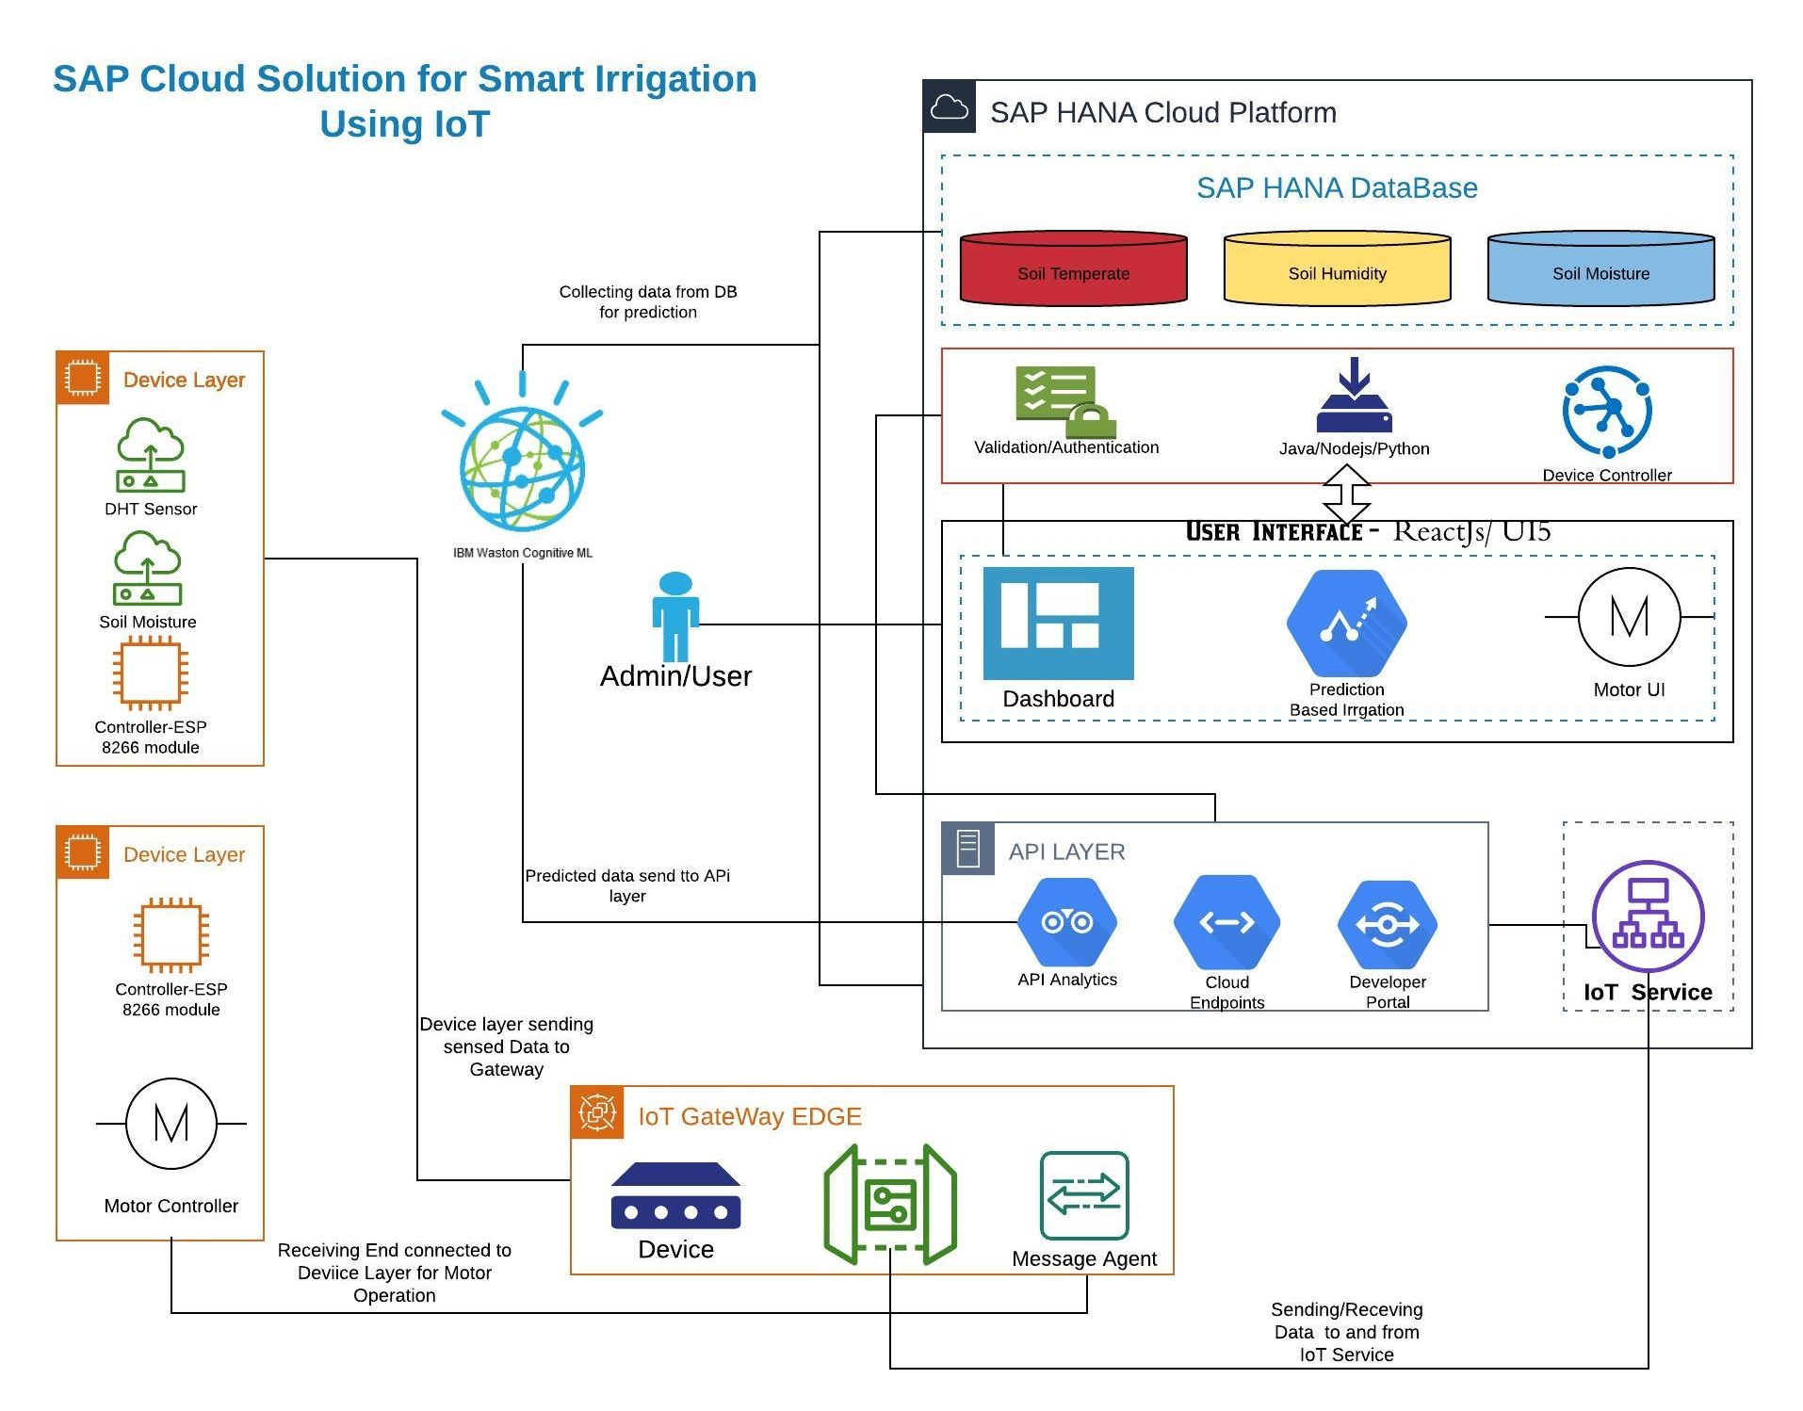
Process flow (Architecture Diagram)
This diagram show how the whole system would work in Sync
It has been divide into Layers for better understanding.
Those layers are Device Layer, API Layer, IoT Gate Edge, Analytics layer, Service Layer and UI Layer.
These all layers are interconnected to each other for completion of whole process

Slide 6
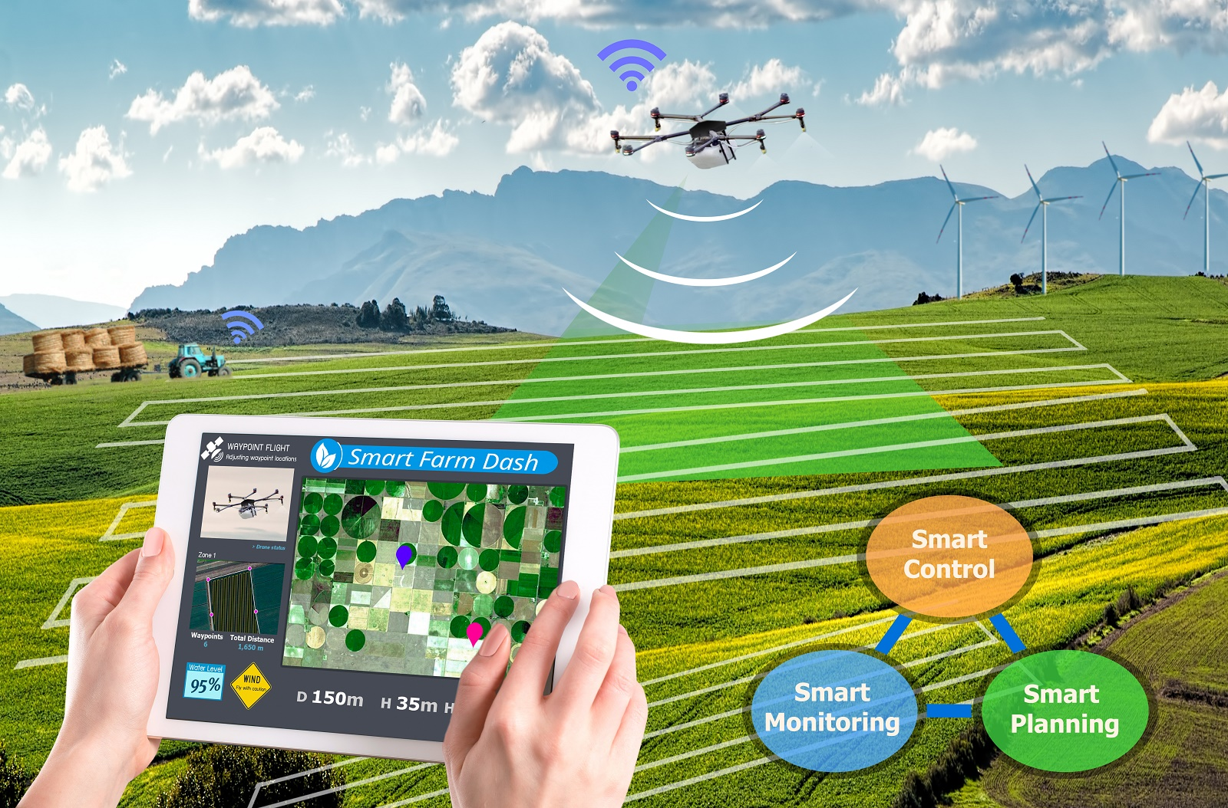
Use Case(s):
Smart Irrigation
Precision Farming
Weather monitoring, Soil Quality, Crop growth
Low risk and High Crop production
Increased business efficiency through process automation

Slide 7
Idea Details:
Data Model:
User1
UserName
Pass(encrpt)
Owner/farmer
Ass. Field(s)
User2….
SAP HANA DB
Table: Users
Field1
Humid
Temp
Soil Moisture
Field 2
Temp
Humid
Soil Moisture
……………..so on
Column Structure
Storing Data
Table: IoT_Data
Table: Prediction
TimeStamp
Field Name
Type of Prediction
Using
User Auth
API
IoT GATEWAY
Backend Service
(Node/Express)
Swagger
API
SAP IoT Leonardo Service Cockpit
MQTT->PAHO
DATA Send

Slide 8


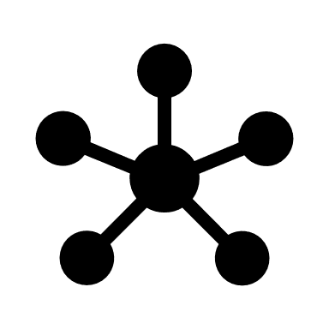




Idea Details(Contd.):
ML Model:
IBM Watson Cognitive Machine Learning
Model
Building
(SVC Algo)
Training Code
Trained Model
Deployed
Model
Production
Labeled data
(csv file)
Web App

Slide 9
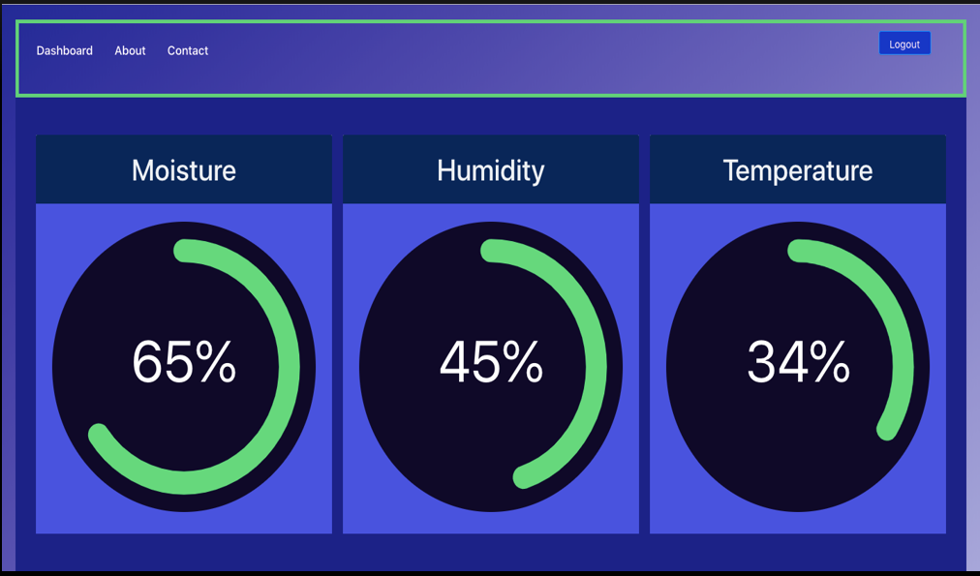
Idea Details(Contd.):
UI Model:
Dashboard: Shows the real time sensed data from sensors of a particular field
Field Name | Soil Moisture | Humidity | Temperature | Prediction | Date & Time
Field 1 | 65% | 45% | 34 C | Optimum | 22/05/2020 : 09:00
Field 2 | 20% | 35% | 40 C | Highly required | 25/05/2020 : 13:00
Dashboard: with table showing collected data with timestamp

Slide 10
Idea Details(Contd.):
Dashboard: Data visualization with Machine learning Algorithms
Q&A
Optimum Level
Irrigation Required (Current Prediction)
No Irrigation
Dashboard: Current Prediction displayed

Slide 11
Idea Details(Contd.):
Business (Logic) Layer:
Logic Building
Current Prediction
Stop motor Automatically
Start Motor automatically
Logic layer play the important role and it connects all the other layers to UI layer.
It triggers functions to call API and perform respective task
Business layer would help in authorizing and authenticating the users , fetching API to get real time data from DB, Controller motor command and send back message to Device layer for action.

Slide 12
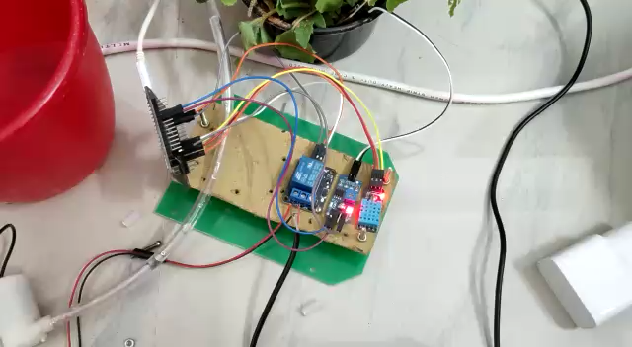
Demo:
Working Demo:

Slide 13
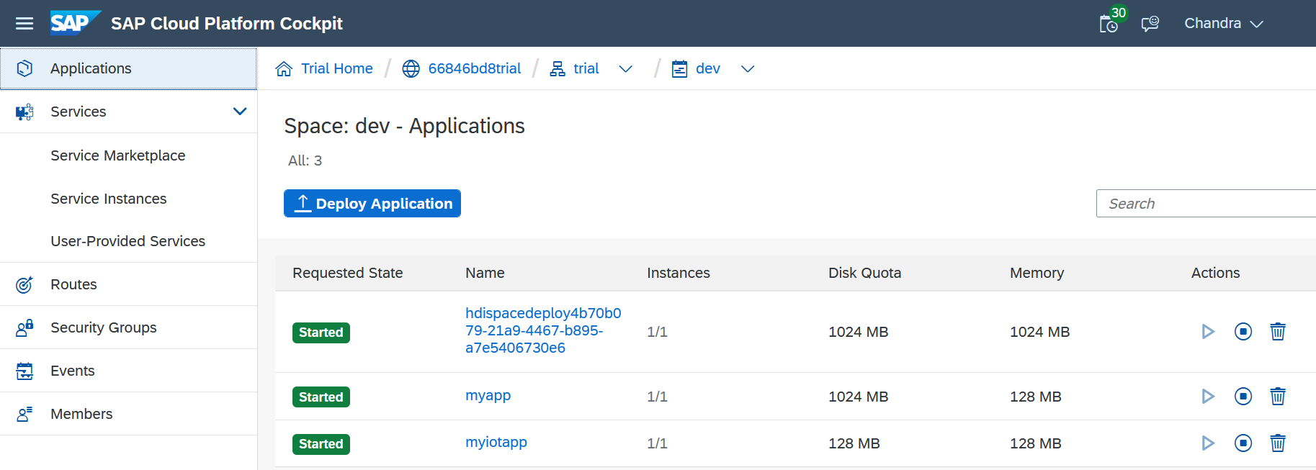
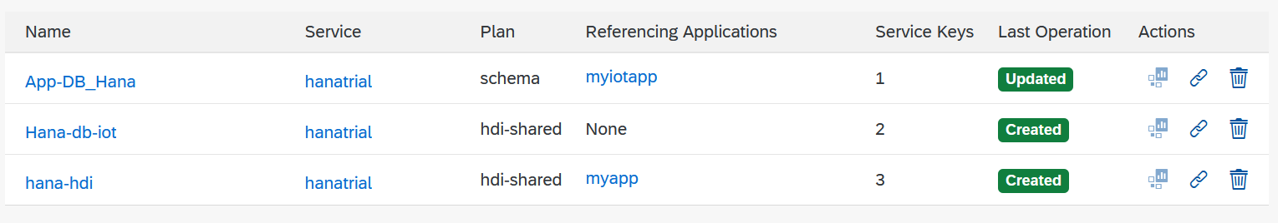
Demo(Contd.)
Work Progress:
Application Services in SAP Cloud Platform(SCP)
Database Services in SAP Cloud Platform(SCP)

Slide 14
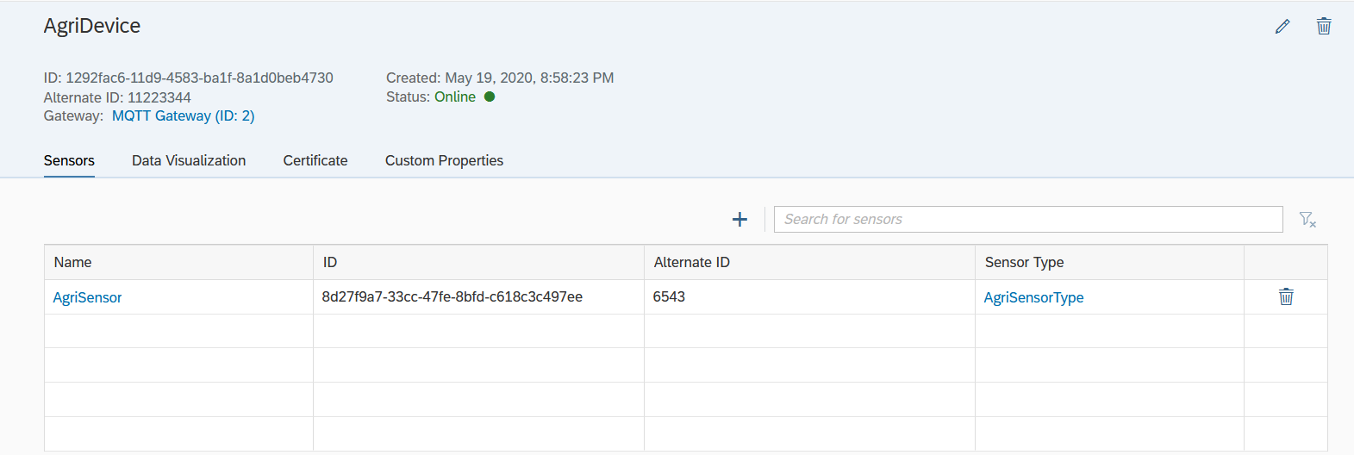
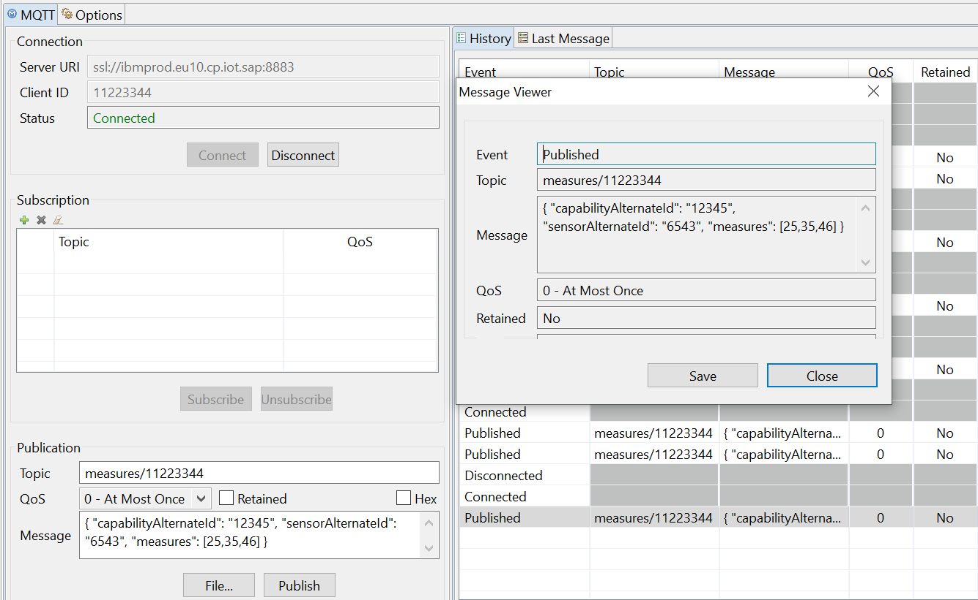
Demo(Contd.)
Work Progress:
SAP IoT Leonardo Services (Showing the IoT Service and device details)
To connect SAP IoT Leonardo Services using MQTT Gateway (Gateway layer)

Slide 15
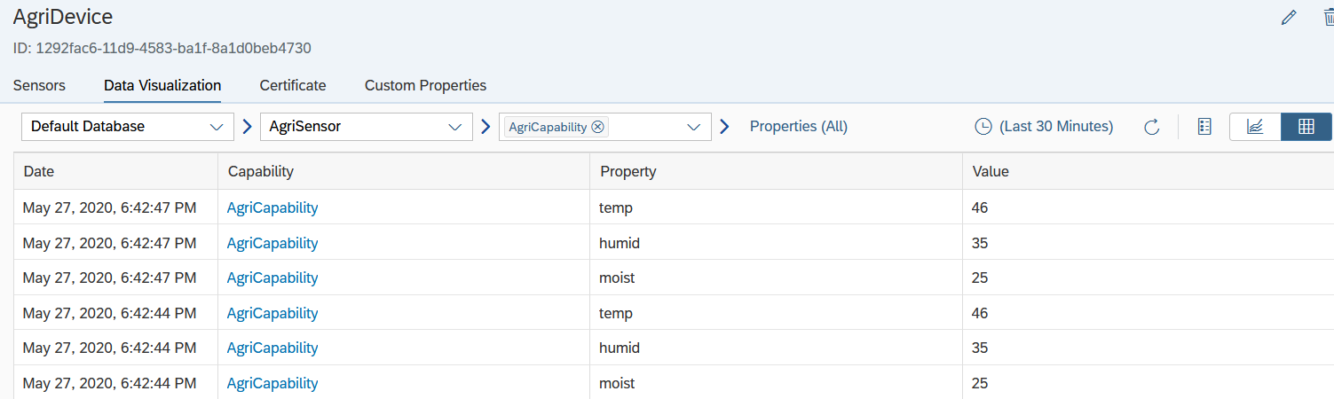
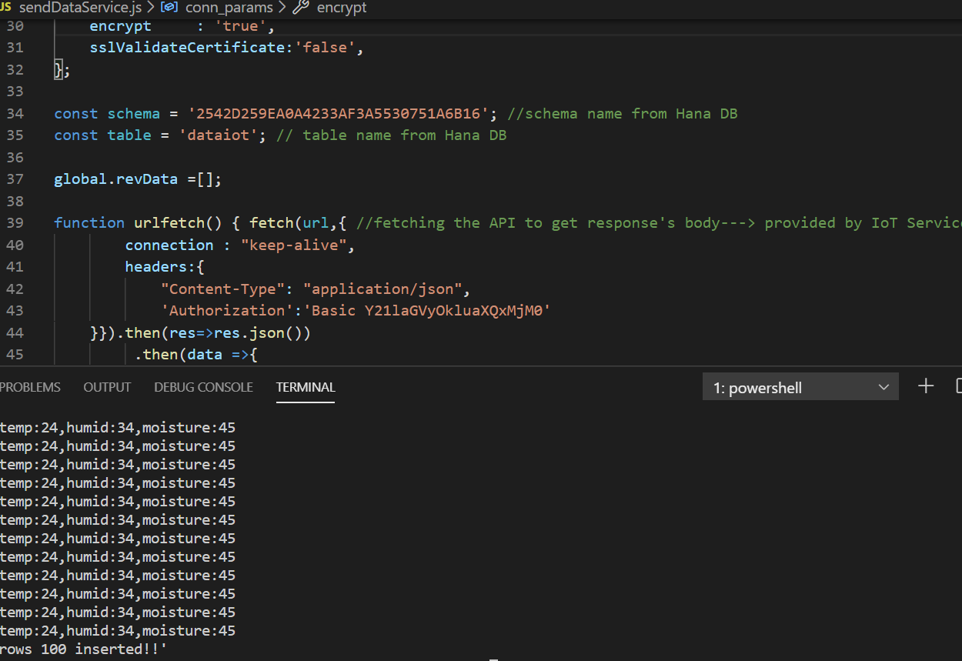
Demo(Contd.)
Work Progress:
SAP IoT Leonardo Services (Collected data ta service layer from gateway)
Business Layer setting up connectivity with service layer and SAP Hana DB

Slide 16
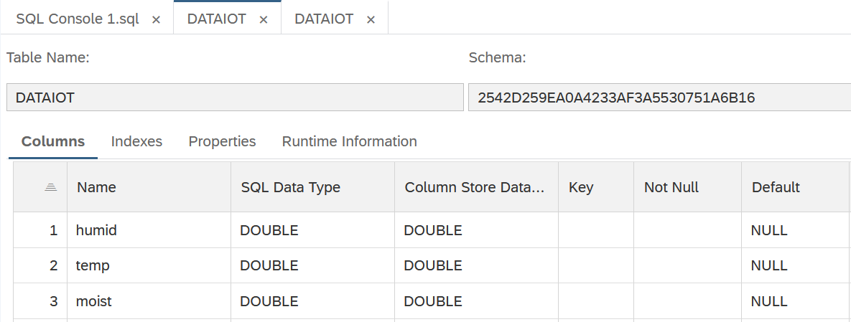
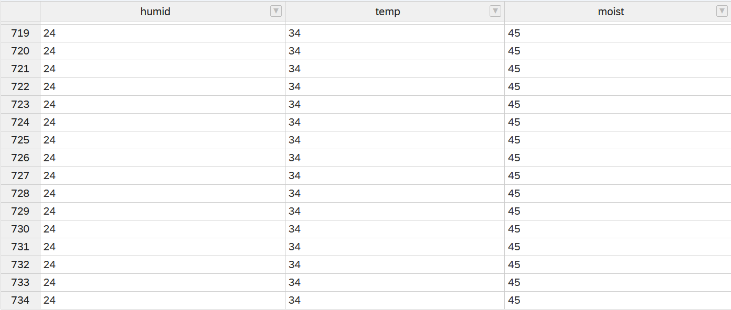
Demo(Contd.)
Work Progress:
Schema and Table DATAIOT details -> Column structure
Stored data in Hana DB

Slide 17
Expected Benefits:
As in other industries, the application of the Internet of Things in agriculture promises previously unavailable efficiency, reduction of resources and cost, automation and data-driven processes.
Excelled efficiency: Today’s agriculture is in a race. Farmers have to grow more products in deteriorating soil, declining land availability and increasing weather fluctuation. IoT-enabled agriculture allows farmers to monitor their product and conditions in real-time. They get insights fast, can predict issues before they happen and make informed decisions on how to avoid them
Expansion. By the time we have 9 billion people on the planet, 70% of them will live in urban areas. IoT-based agriculture systems enable short food supply chains and should be able to feed the people
Reduced resources: Plenty of ag IoT solutions are focused on optimizing the use of resources—water, energy, land. Precision farming using IoT relies on the data collected from diverse sensors in the field which helps farmers accurately allocate just enough resources to within one plant
Improved product quality: Data-driven agriculture helps both grow more and better products. Using soil and crop sensors, farmers better understand detailed dependencies between the conditions and the quality of the crops
As a result, all of these factors can eventually lead to higher revenue.

Slide 18
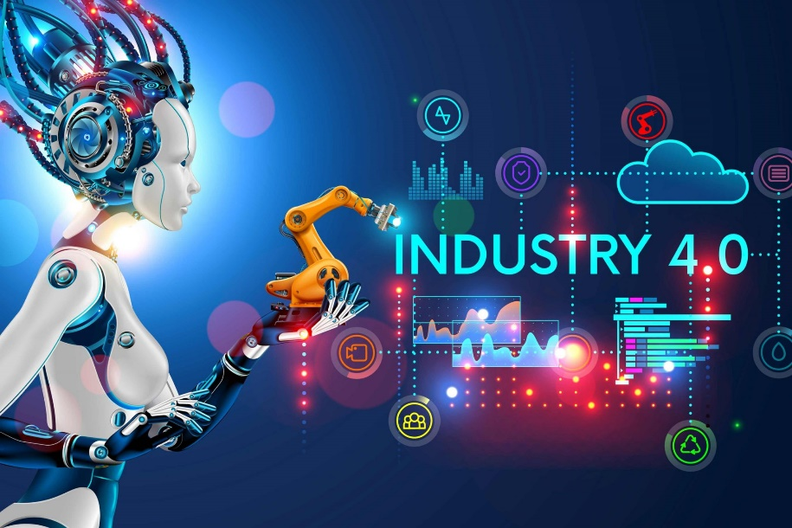
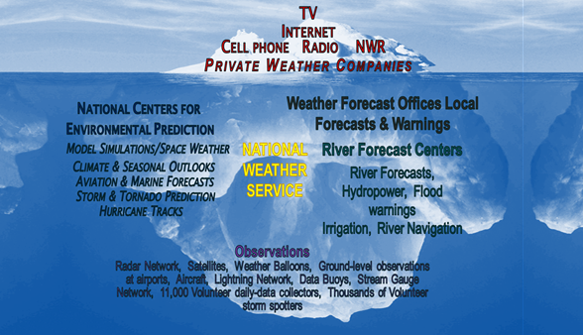
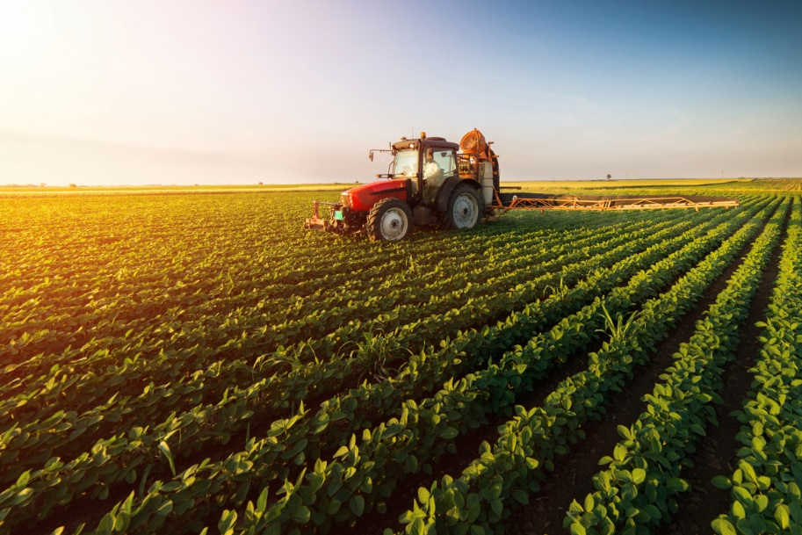
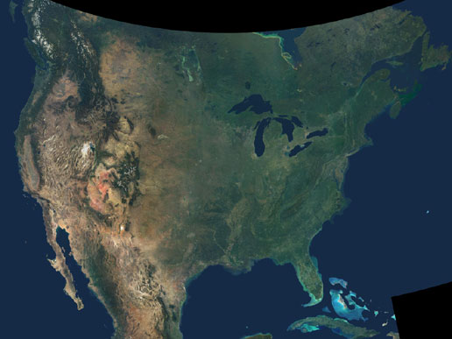
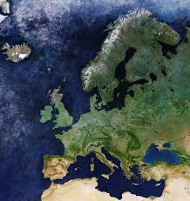
Target Industries and Countries
Automation Industry
Weather Monitoring Center
Agriculture Industry(Smart and Precise farming)

Slide 19
Dissemination of work
Chandra Prakash Meher, Adyasha Sahoo and Suraj Sharma, “IoT based Irrigation and Water Logging monitoring system using Arduino and Cloud Computing”,International Conference on Vision Towards Emerging Trends in Communication and Networking (ViTECoN),IEEE ,[30-31 March,2019]. Published
Chandra Prakash Meher, Adyasha Sahoo and Suraj Sharma, “Decision Support Smart Irrigation using IoT”.

Slide 20
Q & A
Thank You

